Slide 2
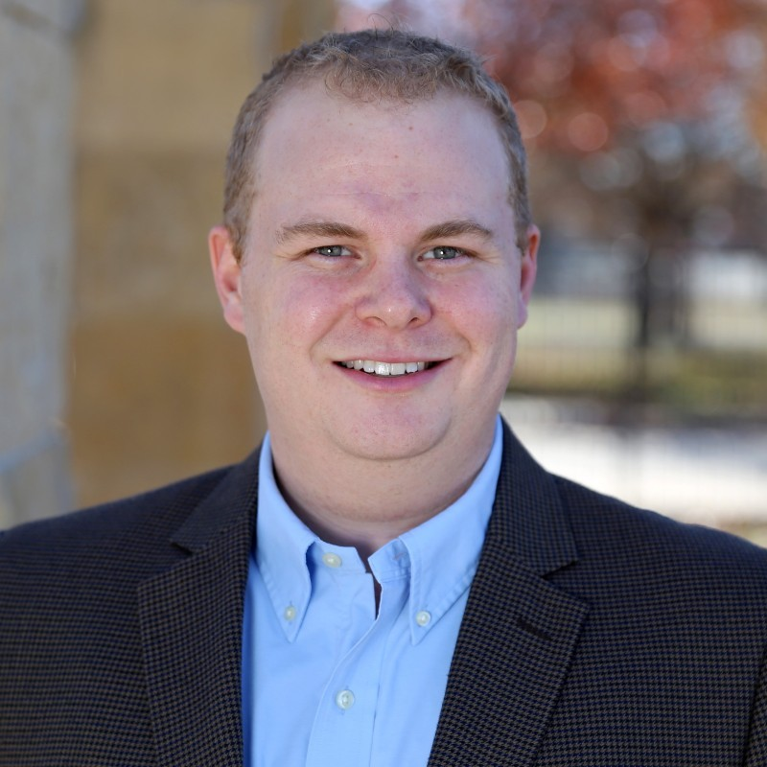
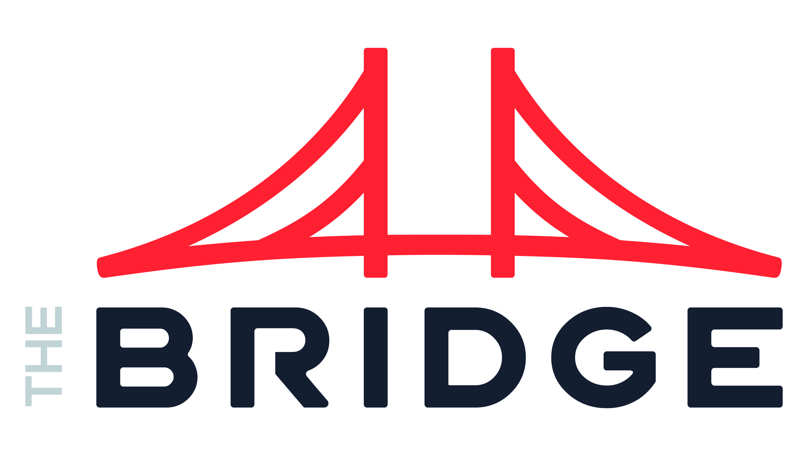
INDUSTRIES
Grady Roach AI, ML, Econometrics
Industry Experience
Telco | Financial Services | Technology | Automotive | Airline | CPG
EXPERIENCE
Field Ops Scheduling | Telco
Strategic advisor and architect for scheduling solution that accounts 4K+ union rules based on geographic location, capacity requirements, and 40K+ field operations team to guarantee teleco installations/ repairs
Solution was optimized the amount of time to schedule field groups, reducing it by 90%. Solution increased customer satisfaction by 45% and works enjoyment of schedule by 80%
Advised client on other modules of scheduling, discussing the impact of solution on routing, job prioritization, and equipment tracking.
ML Platform & Op Model | Automative
Served as client lead and strategic advisor for implementation of an Enterprise ML Platform, supporting 100 + data scientists and an additional 75+ analytic super users
Led team of 18 engineers and 4 strategy consultants to reimagine their ML Platform and Operating Model. Migrated clients SAS based Models to the platform and helped implement a new operating model to treat analytics as a product
Advised clients on best tools and platforms for creation of platform and worked with vendors to assist client with pricing and SME hours
BACKGROUND
Functional Skills
Advanced Analytics, Data Science, Econometrics, Applied AI, Intelligent Products, Product Development, Data Strategy, Business Strategy
Qualifications:
Grady has worked across the Fortune 100, helping clients achieve their analytical dreams by help implement solutions and provide training to teams. Grady brings a background creating algorithms and applications that marry together data science and operational processes, helping business drive outcomes through automation and systems design.
BIO & CONTACT INFO
Email
Grady.roach@thebridge.com
Mobile
469-525-1428
Location
DFW, Texas
Grady joined The Bridge in June 2024. He has a background in helping merge operations and analytics in a way that enables businesses. Grady is glad to lean into clients trickiest problems, ensuring that they receive solutions that change their business.

